Slide 1

Real-Time Financial Insights Dashboard
By Ayush Sengar

Slide 2
Objective
Build a real-time financial monitoring system that streams market data and generates insights with GenAI. Users can query markets and get grounded, live summaries and predictions with risk assessment.
Problem & Motivation
Problem: Individual investors lack a single platform for real-time market tracking, portfolio management, and AI-based financial insights.
Impact: Manual tracking → delayed decisions, lack of clarity → poor investment outcomes.
Motivation: Build a real-time financial dashboard that simplifies insights, improves decisions, and enhances user experience.

Slide 3



Solution Overview
Portfolio tracking & valuation
Live market data visualization
AI-powered financial assistant
Goals
Automation
Efficiency
Real-time updates
User-friendly interface
Use cases
Track personal stock portfolio live
Get AI insights for financial queries
Monitor market summary in real time

Slide 4

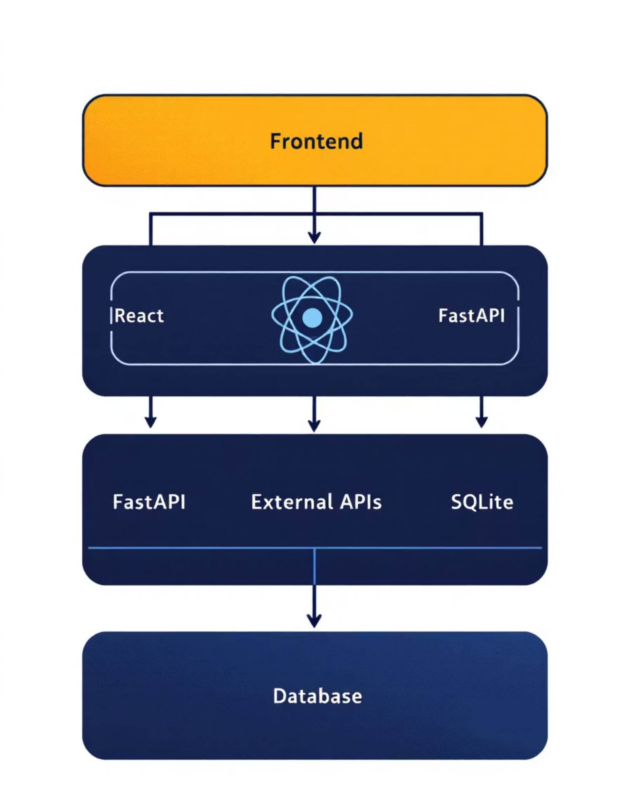
System Architecture
Frontend (React)
Backend (FastAPI)
Components (Dashboard, Portfolio)
WebSocket
Business services
Context API
SQLAlchemy
Axios
JWT auth
Recharts
Caching
Tailwind
External APIs
Database
Finnhub (market data)
SQLite (User, Portfolio, Holdings, Alerts, MarketData, AIInsights)
Google Gemini (AI)

Slide 5
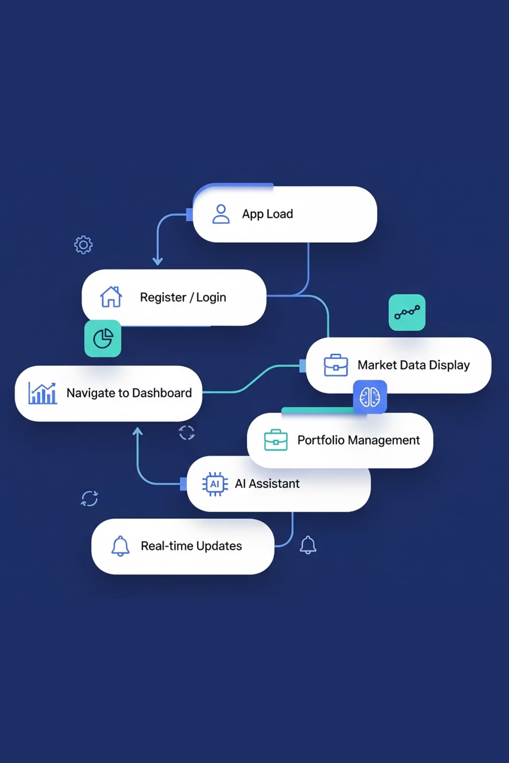




Data Flows
Authentication Flow
Login → FastAPI → JWT token → Stored in frontend → AuthContext
Market Data Flow
REST (polling) + WebSocket (live updates)
Portfolio Flow
CRUD portfolios, calculate value using live prices
AI Assistant Flow
User query → FastAPI → Gemini API → AI response in chat

Slide 6
Technical Highlights
Frontend
Integrations
React + Context API
Finnhub for live market data (with caching)
Recharts for charts
Google Gemini for AI insights
Tailwind for responsive design
Design choices
Backend
FastAPI > Django/Express (async, lightweight)
FastAPI async APIs
SQLite for dev, upgradable to PostgreSQL
JWT security
Context API > Redux (lighter for scale)
WebSocket support
REST + WebSocket hybrid approach
SQLAlchemy ORM

Slide 7
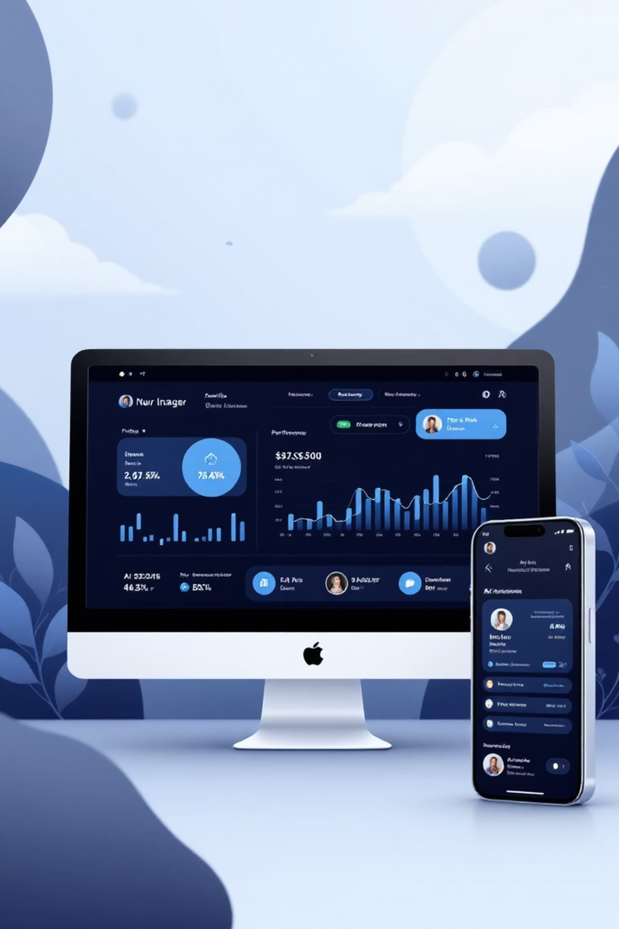
Results & Future Enhancements
Key Achievements
Future Enhancements
Real-time market data integration
WebSocket support in frontend (true real-time)
Secure authentication with JWT
Advanced portfolio analytics
Native mobile app (React Native)
Expanded AI features (personalized finance advice)
AI-powered insights
Social/community features
Responsive UI with data visualizations

